Slide 1
Notes:
Introduce yourself and why you are presenting.

Slide 2

National Instruments
Helping Engineers Since 1976
Tecnología Educativa sa
Asistiendo al sistema educativo argentino desde 1996
Ing. Christian Soto
Ing. Sergio San Román
National Instruments
Tecnología Educativa sa

Slide 3
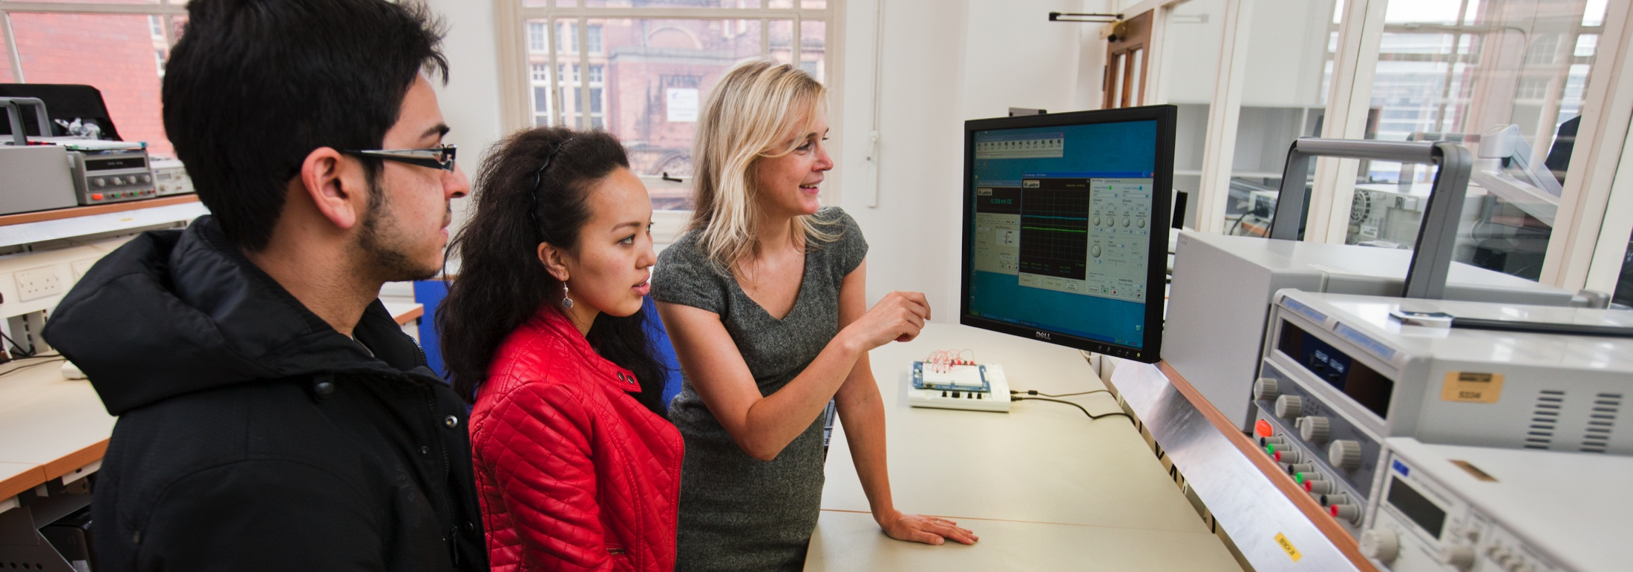
8000+
Laboratorios y Aulas
que usan soluciones
de NI
140,000+
Dispositivos experimentales
en manos
de estudiantes
4M+
de futuros innovadores
ya han usado nuestra
plataforma

Slide 4
Nuestros clientes son exitosos

Slide 5







































Notes:
Around the world – including here in <insert region> - we have seen academic institutions Doing Engineering throughout their educational and research initiatives.

Slide 6


Slide 7


Estado de situación
Aug. 3-6, 2015
Aug. 3-6, 2015
Vivimos en un mundo atravesado por la tecnología
Esta, a su vez, evoluciona y se complejiza a un ritmo acelerado
Precisamos desesperadamente muchos y buenos ingenieros
National Instruments es un líder de la industria tecnológica, con larga trayectoria y vasta experiencia, y comprende perfectamente qué significa ser un buen ingeniero
Ha desarrollado una serie de herramientas para investigación y desarrollo (LabVIEW entre ellas), así como procedimientos y programas de actividades dedicados a la enseñanza de las ingenierías
La soluciones de NI han sido usadas en muchas universidades con resultados muy satisfactorios para todos los involucrados, produciendo cambios de magnitud
Aug. 3-6, 2015
Aug. 3-6, 2015
Aug. 3-6, 2015
Aug. 3-6, 2015
Aug. 3-6, 2015
Electric Power Steering
Notes:
Technology is moving at an unprecedented pace. Our customers across every industry are seeing technologies converge, resulting in the increased complexity of their systems. This is true in connected cars, in smartphones, in semiconductor chips, and in smart factories.
More and more of the functionality of these technologies is being defined in software; therefore, their capabilities are rapidly changing. Engineers who are designing and testing these systems are struggling to create monitoring, control, and test systems that can improve at the rate of these technologies and not just keep up but take advantage of these trends in a way that enables them to get their jobs done faster and more efficiently.

Slide 8
Un ejemplo argentino…
Aug. 3-6, 2015
Aug. 3-6, 2015
En Argentina, a fines de 2017, la UTN adquirió, en condiciones muy ventajosas, una licencia que le da acceso a todos los componentes importantes del software desarrollado por NI
Esta licencia:
Alcanza a todas las Regionales de la UTN
Permite instalar el software provisto en todas la computadoras que pertenezcan a la UTN y residan permanentemente dentro de sus instalaciones
Es vitalicia
Incluye un importante programa de soporte y perfeccionamiento profesional de renovación anual
Aug. 3-6, 2015
Aug. 3-6, 2015
Aug. 3-6, 2015
Aug. 3-6, 2015
Aug. 3-6, 2015
Electric Power Steering
Notes:
Technology is moving at an unprecedented pace. Our customers across every industry are seeing technologies converge, resulting in the increased complexity of their systems. This is true in connected cars, in smartphones, in semiconductor chips, and in smart factories.
More and more of the functionality of these technologies is being defined in software; therefore, their capabilities are rapidly changing. Engineers who are designing and testing these systems are struggling to create monitoring, control, and test systems that can improve at the rate of these technologies and not just keep up but take advantage of these trends in a way that enables them to get their jobs done faster and more efficiently.

Slide 9
Estado de situación…
Aug. 3-6, 2015
Aug. 3-6, 2015
La UTN tiene unos cuantos docentes que ya son usuarios aislados de LabVIEW y hardware de NI
Si la plataforma se usa de manera aislada, parcial o casual, su impacto sobre el sistema no va a ser relevante
Si la aprovechan pueden aportar a su proceso educativo con:
Aprendizaje con manos en la masa
Trabajo en grupo
Trabajos de proyecto
Aprendizaje por indagación
Solvencia en el uso de una herramienta estándar de la industria
Posibilidad de acometer proyectos complejos y ambiciosos
Aug. 3-6, 2015
Aug. 3-6, 2015
Aug. 3-6, 2015
Aug. 3-6, 2015
Aug. 3-6, 2015
Electric Power Steering
Notes:
Technology is moving at an unprecedented pace. Our customers across every industry are seeing technologies converge, resulting in the increased complexity of their systems. This is true in connected cars, in smartphones, in semiconductor chips, and in smart factories.
More and more of the functionality of these technologies is being defined in software; therefore, their capabilities are rapidly changing. Engineers who are designing and testing these systems are struggling to create monitoring, control, and test systems that can improve at the rate of these technologies and not just keep up but take advantage of these trends in a way that enables them to get their jobs done faster and more efficiently.

Slide 10
Estado de situación
Aug. 3-6, 2015
Aug. 3-6, 2015
Los resultados pueden tener un gran impacto social:
Mejores profesionales
Empresas más competitivas
Desarrollos acelerados para atender áreas críticas:
Energía
Comunicaciones
Automatización Industrial
Electromedicina
La institución agregó una herramienta clave para reafirmar su liderazgo e influencia
Aug. 3-6, 2015
Aug. 3-6, 2015
Aug. 3-6, 2015
Aug. 3-6, 2015
Aug. 3-6, 2015
Electric Power Steering
Notes:
Technology is moving at an unprecedented pace. Our customers across every industry are seeing technologies converge, resulting in the increased complexity of their systems. This is true in connected cars, in smartphones, in semiconductor chips, and in smart factories.
More and more of the functionality of these technologies is being defined in software; therefore, their capabilities are rapidly changing. Engineers who are designing and testing these systems are struggling to create monitoring, control, and test systems that can improve at the rate of these technologies and not just keep up but take advantage of these trends in a way that enables them to get their jobs done faster and more efficiently.

Slide 11
Nuestra propuesta para esta reunión
Aug. 3-6, 2015
Aug. 3-6, 2015
Revisar los antecedentes:
¿Qué hace National Instruments?
¿En qué consisten sus soluciones?
Algunos ejemplos de uso en Industria y Educación
Revisar en detalle con qué cuenta su institución ahora
Trazar un plan de implementación
Aug. 3-6, 2015
Aug. 3-6, 2015
Aug. 3-6, 2015
Aug. 3-6, 2015
Aug. 3-6, 2015
Electric Power Steering
Notes:
Technology is moving at an unprecedented pace. Our customers across every industry are seeing technologies converge, resulting in the increased complexity of their systems. This is true in connected cars, in smartphones, in semiconductor chips, and in smart factories.
More and more of the functionality of these technologies is being defined in software; therefore, their capabilities are rapidly changing. Engineers who are designing and testing these systems are struggling to create monitoring, control, and test systems that can improve at the rate of these technologies and not just keep up but take advantage of these trends in a way that enables them to get their jobs done faster and more efficiently.

Slide 12
¡Comencemos!

Slide 13
















Un mundo con tecnologías y dispositivos concurrentes
Aug. 3-6, 2015
Aug. 3-6, 2015
Más funciones definidas por software
Cambio permanente y acelerado de las especificaciones
Circuitos de diseño y ensayo más complejos
Aug. 3-6, 2015
Aug. 3-6, 2015
Aug. 3-6, 2015
Aug. 3-6, 2015
Aug. 3-6, 2015
Electric Power Steering
Notes:
Technology is moving at an unprecedented pace. Our customers across every industry are seeing technologies converge, resulting in the increased complexity of their systems. This is true in connected cars, in smartphones, in semiconductor chips, and in smart factories.
More and more of the functionality of these technologies is being defined in software; therefore, their capabilities are rapidly changing. Engineers who are designing and testing these systems are struggling to create monitoring, control, and test systems that can improve at the rate of these technologies and not just keep up but take advantage of these trends in a way that enables them to get their jobs done faster and more efficiently.

Slide 14
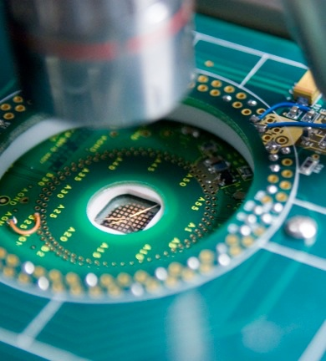
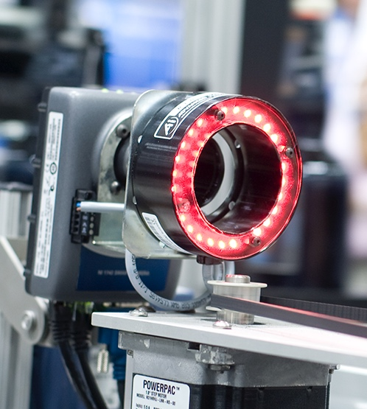

Misión
NI ayuda a científicos e ingenieros con sistemas que aceleran los descubirmientos, la productividad y la innovación.
Notes:
NI has been addressing these challenges by creating highly productive systems for engineers and scientists. We fundamentally believe that by making engineers and scientists more productive we can have the greatest impact on your business and on society overall.

Slide 15
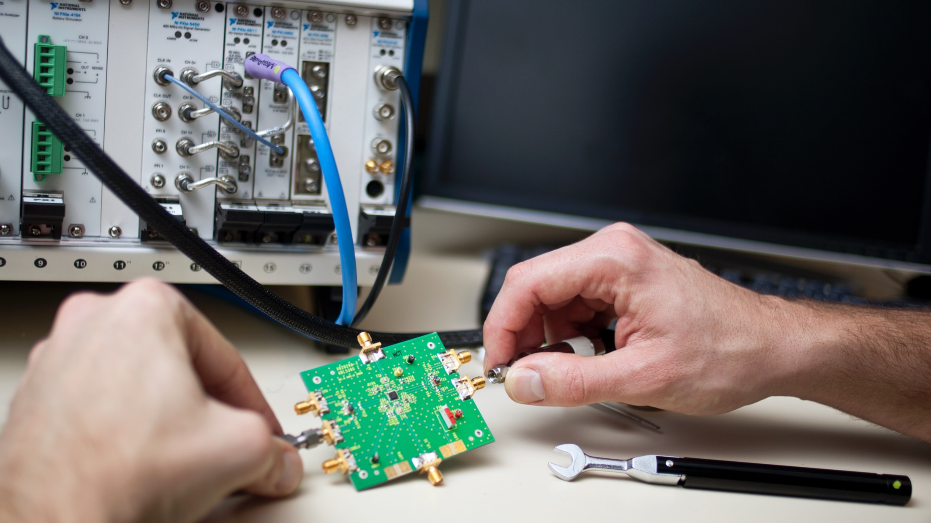






Cuatro décadas en la cresta de la ola
1977
Introduces GPIB to connect instruments to mini computers
1986
LabVIEW starts the computer-based measurement revolution
1991
Creates the Alliance Partner Network to strengthen ecosystem
2004
Makes FPGAs accessible to engineers and scientists
2013
Introduces software-designed instrumentation
2017
Introduces LabVIEW NXG
2020
1976
NI founded
1983
Introduces first GPIB board
to connect instruments to IBM PCs
1987
Releases data acquisition solutions to provide accurate measurements
1998
Creates PXI and expands opportunities with complete system solutions
2006
Announces CompactDAQ
to increase measurement accuracy
2014
Leads 5G system prototyping
and releases STS
Notes:
And for 40 years, NI has been a catalyst in accelerating engineering innovation to meet these kinds of challenges.
We’ve pioneered a software-based approach to test, measurement, and control that has enabled our customers to build systems to meet the unique requirements of their applications. And we’ve been on the leading edge of technologies like graphical software, modular hardware standards, and FPGAs. Our mission has been to leverage the advancements in these technologies and deliver them to engineers and scientists in a way that shortens their time to build a test, measurement, or control system. For example, NI has been at the leading edge of applying user-programmable FPGAs to design high-performance measurement and control systems; this capability has enabled our platform to become a leading solution for prototyping the next generation of communications systems in 5G wireless.
Points for each Timeline Milestone:
1976: NI was founded by Dr. James Truchard, Jeff Kodosky, and Bill Nowlin. Working for The University of Texas on a project conducting research for the U.S. Navy, the men were using early computer technology to collect and analyze data. Frustrated with the inefficient data collection methods they were using, the three decided to create a product that would enable their task to be done more easily. ^{[5]}
1977: Introduced first product, GPIB, which connects instruments to mini computers. The group bought a PDP-11/04 minicomputer and, for their first project, designed and built a GPIB interface for it.
1983: Developed first GPIB board to connect instruments to IBM PCs; paved way for new graphical interfaces.
1986: LabVIEW starts the computer-based measurement revolution: Kodosky began a research initiative with the assistance of student researchers at The University of Texas on ways to exploit the new interface. This led to the creation of NI's flagship product, the LabVIEW graphical development platform for the Macintosh computer. The software allows engineers and scientists to program graphically by "wiring" icons together instead of typing text-based code. By allowing people to use a more intuitive, less-structured development environment, their productivity greatly increased, making LabVIEW quite popular.
1987: Introduced DAQ: Our DAQ hardware and driver software products are “instruments on a board” that users can combine with sensors and signal conditioning hardware and software to acquire analog data and convert it into a digital format that can be accepted by a computer. NI offers customizable measurement software that features all the components you need to acquire, analyze, present, and manage your measurement data. We also provide the widest selection of high-quality DAQ hardware that features high-accuracy analog designs, integrated signal conditioning, and precision timing for any sensor or signal. We offer a range of computer-based DAQ products with a variety of form factors and degrees of performance.
1991: NI creates the Alliance Partner Network to strengthen ecosystem: To further assist its customers, NI created the National Instruments Alliance Partner Network, attracting a worldwide selection of third-party developers, systems integrators, and consultants who could extend the capabilities of the NI hardware and software.
1998: NI creates PXI and expands opportunities with complete system solutions: Our PXI modular instrument platform, which was introduced in 1997, is a standard PC packaged in a small, rugged form factor with expansion slots and instrumentation extensions for timing, triggering, and signal sharing. It combines mainstream PC software and PCI hardware with advanced instrumentation capabilities.
2004: NI makes FPGAs accessible to engineers and scientists: CompactRIO (or cRIO) is a real-time embedded industrial controller for industrial control systems. The CompactRIO device is a combination of a real-time controller, reconfigurable I/O modules (RIO), FPGA module, and an Ethernet expansion chassis. CompactRIO controllers can be programmed with LabVIEW, C, C++, or Java. LabVIEW must be used to program the embedded FPGA.
2006: NI announces CompactDAQ to increase measurement accuracy: In 2006, we introduced CompactDAQ, a rugged, portable, USB data acquisition system designed for high-performance mixed-signal measurement systems. Since its introduction, we have expanded the CompactDAQ line with wireless and Ethernet technologies that have extended the reach of computer-based DAQ from across the lab to around the world.
2013: NI introduces software-designed instrumentation: A vector signal transceiver (VST) is a new class of instrumentation that combines a vector signal generator (VSG) and vector signal analyzer (VSA) with FPGA-based real-time signal processing and control. The world’s first VST from National Instruments also features a user-programmable FPGA, which allows you to implement custom algorithms directly into the hardware design of the instrument. This software-designed approach allows a VST to have the flexibility of a software defined radio (SDR) architecture with RF instrument-class performance.
2014: NI leads prototyping of 5G systems: The LabVIEW Communications System Design Suite offers a design environment closely integrated with NI software defined radio (SDR) hardware for rapidly prototyping communications systems. Easily deploy to processors and FPGAs; quickly develop LTE, 802.11, and massive multiple input, multiple output (MIMO) applications; and drive innovation.
2014: The STS delivers the openness and flexibility of the NI PXI platform to the semiconductor production environment. For easy integration into the production test cell, the STS comes with features such as handler/prober integration, spring probe device under test interfacing, STDF data reporting, and system calibration.
2017: LabVIEW NXG allows customers to configure, automate, and visualize your test results, all within a single tool. Customers can reduce their time to measurement with automatic instrument driver identification for thousands of instruments, and then rapidly customize their system with an integrated drag-and-drop design approach. Results can be viewed from anywhere by building web-based user interfaces that can be deployed to any web browser–PC, tablet, or phone–with no plugins or installers.

Slide 16
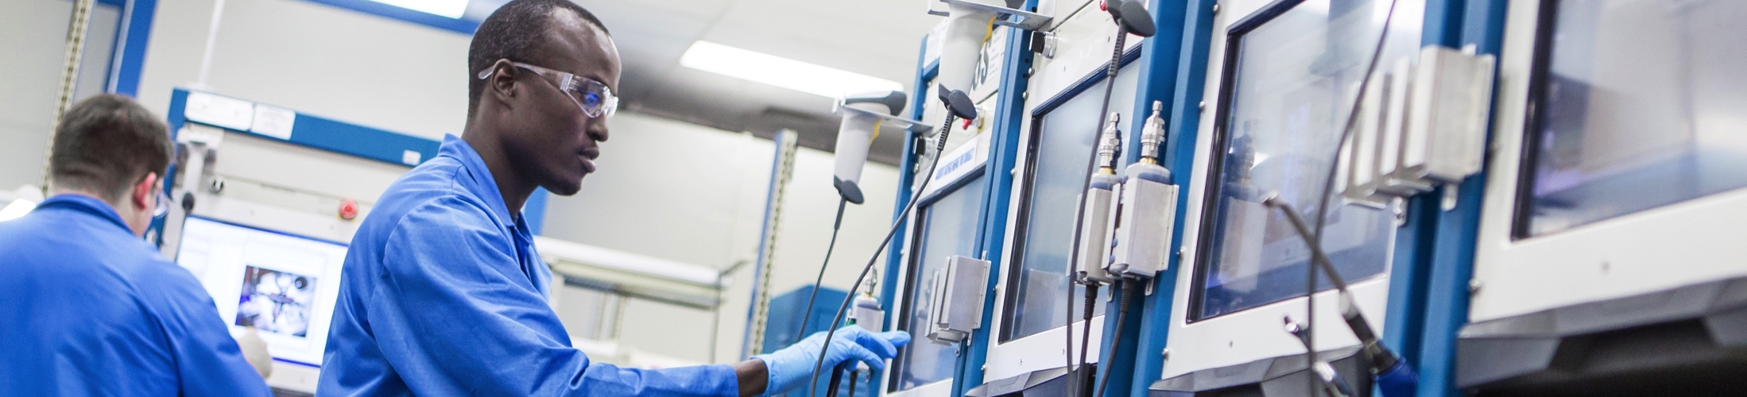


Una empresa importante Crecimiento histórico
1290
MILLONES DE USD EN 2017
PRESENTE EN MAS DE 50 PAISES
MAS DE 35.000 CLIENTES
INVERSION DEL16% I&D
Revenue in millions USD
Notes:
To do this effectively, and support our customers over the long term, we have to be a good business. For more than 40 years running, NI has maintained a strong track record of sustainable growth and profitability, and we’re one of the most successful companies in our space. This growth comes from executing a long-term view in decision making, having an unwavering dedication to innovation, and continuing a deep commitment to the success of our customers.
The stability of our model comes from a very broad base of customers—over 35,000 customers each year, with all the divisions of GE, for example, counting as one of those customers.
Our long-term commitment is also reflected in our investment in R&D. Because when you chose our platform, you aren’t just buying a system for today, you’re investing in future capability that we’ll deliver in that platform. By investing 16 percent of our revenue into R&D—the highest percentage in our industry—we are committing to continue to deliver on capability that enables you to upgrade your system over time and keep up with the increasing pace of technological innovation.

Slide 17
Una plataforma común para todas las aplicaciones,
estructurada a través de software,
que acelera el desarollo
e incrementa la productividad de
los sistemas de ensayo, medición y control.
Notes:
Our approach is to accelerate productivity, innovation, and discovery through a software-centric platform for developing any system that needs test, measurement, and control.
When spending time and energy making technology work gets in the way of focusing on a solution, we know that’s a big problem. So, our goal is to enable engineers to get their job done faster regardless of their application or industry.
Let’s take a deeper look at the main components of our platform.

Slide 18
SOFTWARE DE 3os
HARDWARE DE 3os
UNA PLATAFORMA COMUN PARA TODO
SERVICIOS Y SOPORTE DE NI
SOFTWARE DE DESARROLLO DE NI
WEB SERVICES
PYTHON
C/ C# /.NET
The MathWorks, Inc. SOFTWARE
VHDL
GNU RADIO
Y MAS
ARDUINO
ETHERNET
USB
GPIB
SERIAL
LXI/VXI
Y MAS
SISTEMA MODULAR DE HARDWARE DE NI
Notes:
NI’s open platform combines three critical and interrelated elements: productive software, modular hardware, and an expansive ecosystem.
Openness has always been a hallmark of how we’ve approached the market; it’s evident in our integration with third-party hardware using technologies like instrument drivers, where we’ve led the industry for several decades; to open software interfaces, so our software tools can integrate with existing code; or to ongoing development in tools like C, The MathWorks, Inc. MATLAB®, and Python.

Slide 19
UNA PLATAFORMA COMUN PARA TODO
SERVICIOS Y SOPORTE DE NI
ECOSISTEMA DE NI
Community
300,000+ Online Members
450+ User Groups
9,000+ Code Examples
SOFTWARE DE 3os
SOFTWARE DE DESARROLLO DE NI
HARDWARE DE 3os
Support
700+ Field Engineers
700+ Support Engineers
50+ Worldwide Offices
ECOSISTEMA DE NI
Academia
8,000+ Classrooms Worldwide
Add-Ons
500+ Software Add-Ons
6M+ Tools Network Downloads
SISTEMA MODULAR DE HARDWARE DE NI
Partners
1,000+ Alliance Partner Companies
Industry-Leading Technology Partners
Open Connectivity
10,000+ Instrument and Device Drivers
1,000+ Sensor and Motor Drivers
Notes:
This open platform has given rise to an ecosystem of developers, partners, and third-party products that is unrivaled in our industry. This ecosystem ensures that you have the tools and expertise you need to build any system. It includes a community of over 300,000 developers, a footprint at over 8,000 classrooms worldwide, over 10,000 supported hardware devices, and over 1,000 Alliance Partners that have expertise on our platform and provide integration services and consulting.
This open platform enables you to define exactly the system you need to accelerate your application, innovate faster, and continually integrate new technologies.
A hallmark of our success has been world-class support and services. With direct operations in more than 50 countries, NI has the local language know-how, on-site services, and expert technical support that help customers continually meet targets and deadlines.

Slide 20
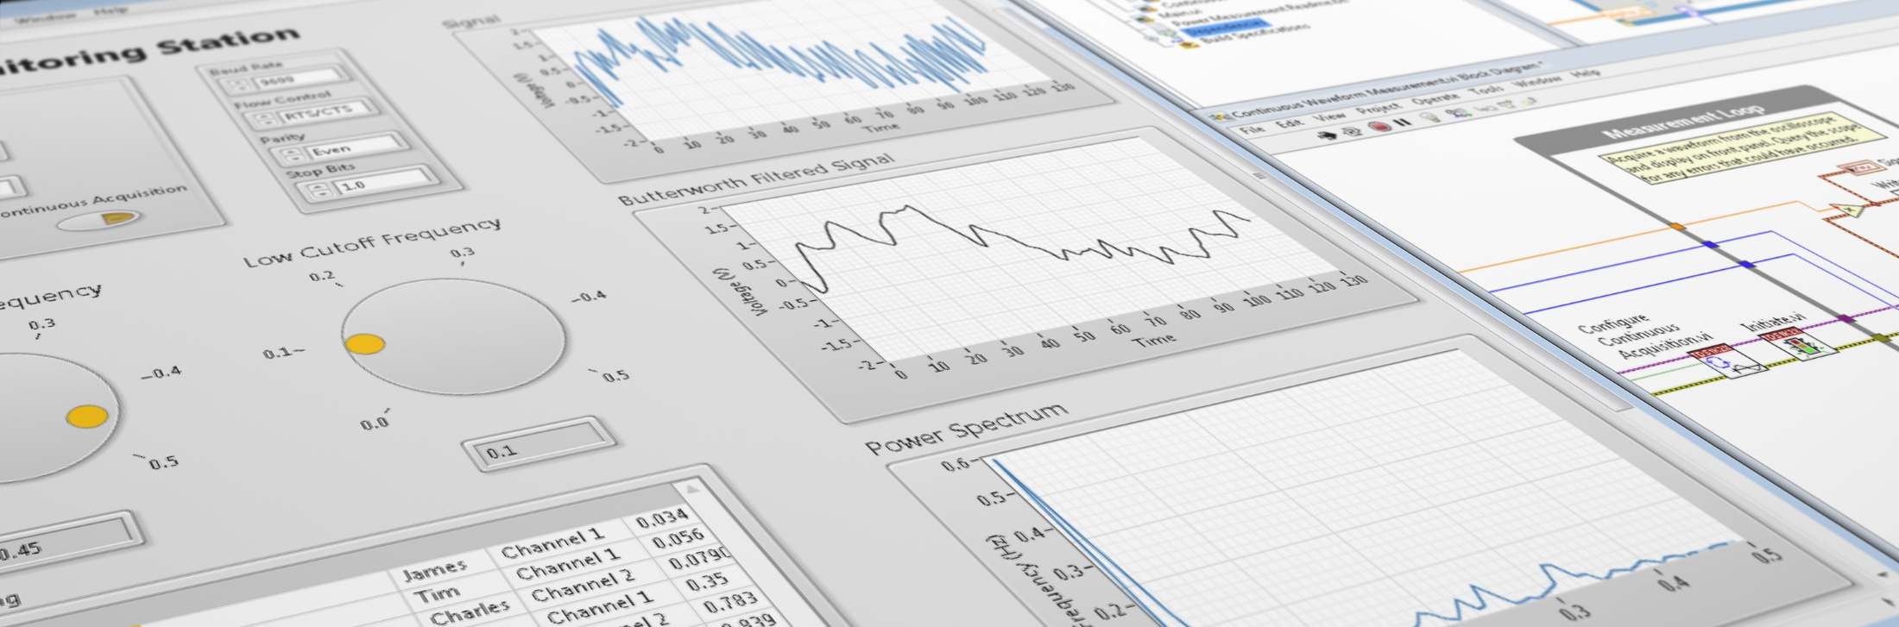

Un software flexible es una buena inversión
TestStand
VeriStand
DIAdem
NI InsightCM™ Enterprise
Multisim
LabWindows™/CVI
Measurement Studio
Third-Party Software
The mark LabWindows is used under a license from Microsoft Corporation. Windows is a registered trademark of Microsoft Corporation in the United States and other countries.
Notes:
At the center of our platform is software. Software has become the critical defining element of every system, and NI has long been a leader in software tools for test, measurement, and control systems. In fact, our mantra has been that the software is the instrument. We invest more in software than anyone in our industry.
Our software platform consists of an extensive set of drivers, development tools, test and data automation environments, and application-specific software packages.
Our flagship development tool is LabVIEW, a development environment designed specifically to accelerate productivity. With a graphical programming syntax that makes it simple to visualize, create, and code engineering systems, LabVIEW has proven to be unmatched in helping reduce test times, accelerate development, and collect and analyze data to impact technical and business decisions.
LabVIEW is also designed to interoperate with other software to ensure you can use all the tools available to you. The result is you can choose the best software product for each aspect of your application, and spend your time focused on the details that matter, without worrying as much about how they work together.
And perhaps the most important element of software is delivering continuity over time to abstract underlying changes in hardware technology. Think of Moore’s law. We think it’s about hardware, but Moore’s law is really a software story; if you had to change out all of your SW apps every time you updated your laptop or phone, you wouldn’t do it. Similarly, NI has delivered continuity over generations of processing, connectivity, and synchronization; so that you can add in these new technologies as they come available and preserve the software investment you’ve made.
Though flexible software is the key component, let’s look at how it works together with modular hardware systems.
Detail on each offering:
TestStand. TestStand is targeted for test and measurement applications in a manufacturing environment. TestStand is a test management environment for organizing, controlling, and running automated prototype, validation, and manufacturing test systems. It also generates customized test reports and integrates product and test data across the customers’ enterprise and across the Internet. TestStand manages tests that are written in LabVIEW, LabWindows™/CVI, Measurement Studio, C and C++, and Microsoft Visual Basic, so test engineers can easily share and reuse test code throughout their organizations and from one product to the next. TestStand is a key element of our strategy to broaden the reach of our application software products across the corporate enterprise.
VeriStand. VeriStand is a ready-to-use software environment for configuring real-time test applications, including hardware-in-the-loop (“HIL”) test systems. With VeriStand, users configure real-time I/O, stimulus profiles, data logging, alarming, and other tasks; implement control algorithms or system simulations by importing models from a variety of software environments; build test system user interfaces quickly; and add custom functionality using LabVIEW, TestStand, and other software environments.
DIAdem. DIAdem offers users configuration-based technical data management, analysis, and report generation tools to interactively mine and analyze data. It helps users make informed decisions and meet the demands of today’s test environments, which require quick access to large volumes of scattered data, consistent reporting, and data visualization.
NI InsightCM Enterprise. NI InsightCM Enterprise is a software solution with tightly integrated hardware options for monitoring critical and ancillary rotating equipment. With this solution, a user can acquire, analyze, and visualize data from a wide breadth of sensors to interpret the health of the user’s machines with confidence. Companies can use this cost-effective, open, and flexible solution to monitor a larger percentage of their fleet and meet evolving maintenance requirements.
Multisim circuit design software. Multisim is an industry-standard Simulation Program with Integrated Circuit Emphasis (“SPICE”) simulation environment. It is the cornerstone of the NI circuits teaching solution to build expertise through practical application in designing, prototyping, and testing electrical circuits.

Slide 21
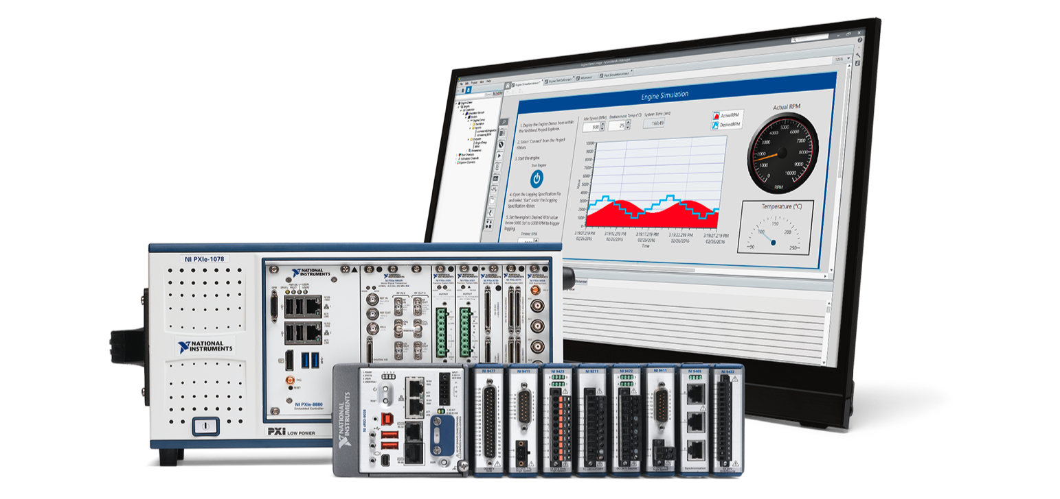






Con hardware modular es fácil hacer ajustes y diseños a medida
Complete I/O Coverage
With More Than 600 Modules
Highest Data Throughput
With PCI Express
Software Extensibility
With Apps, IP, and Toolkits
Parallel Measurement Execution
With Latest Multicore Processors
ADC
Real-Time Measurements
With Timing and Synchronization
Measurement Acceleration
With User-Programmable FPGAs
Reduced Size, Power, and Weight
With Form Factor Variants
Increased Measurement Range
With Latest ADC/DAC
Notes:
NI believes fundamentally that our customers know their requirements better than anyone and should be able to construct the system that exactly meets those requirements.
NI has invented and invested in modular hardware systems like PXI, an industry standard supported by over 70 companies, and CompactRIO, an industrial modular system with a revolutionary FPGA-centric architecture.
In all of these systems, you are able to choose the modules you need for the measurement and control points in your application and upgrade your application over time to add new processing, or new I/O points. These systems also leverage our ecosystem so that even if our products do not meet one of your needs, you can add a third-party module compatible with the same system.
A key part of our modular hardware strategy is to leverage commercial technology. For example, we leverage the latest technologies for moving data at high speeds. We implement the latest multicore processing technology, unleash the power of the FPGAs for increased performance, and take advantage of the latest ADCs and DACs in an open, modular platform that iterates rapidly.
You can choose which hardware and software modules you need for each application, with the ability to change modules from project to project while maintaining platform investment. This means being faster to market while being able to manage obsolescence over time because the system is engineered to grow and change.

Slide 22
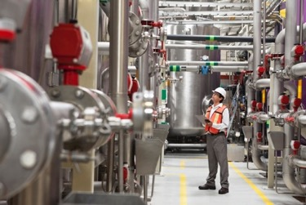

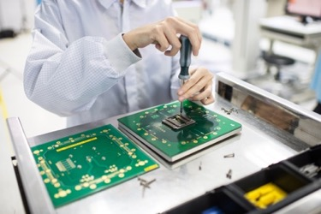
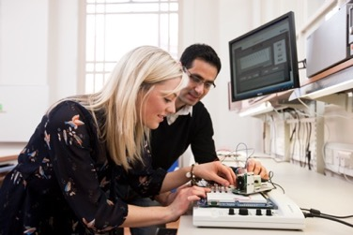
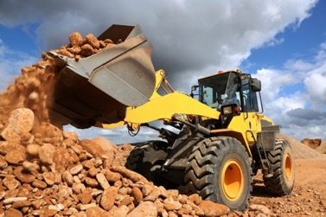
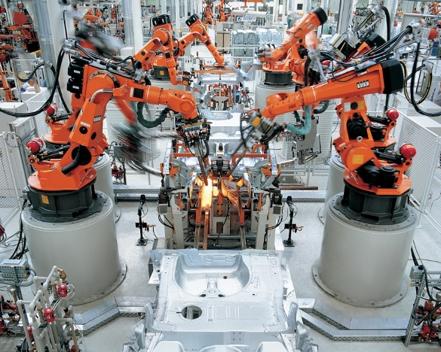
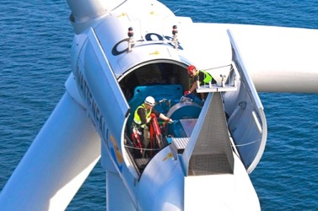

Nuestros clientes son exitosos
Industrial Machinery
Aerospace and Defense
Electronics and Semiconductor
Academic and Research
Industrial Machinery
Aerospace and Defense
Electronics and Semiconductor
Academic and Research
Wireless
Transportation and
Heavy Equipment
Automotive
Energy
Wireless
Transportation and
Heavy Equipment
Automotive
Energy
Notes:
NI products are in every industry that uses technology and creates things. This is possible because of our platform-based approach. Traditionally, engineers in their respective industries haven’t seen the value of companies in other industries using a single-platform approach. Of course, this notion is not hard to understand. In fact, industries often had technologies and requirements that were wholly unique to their industry. But in today’s world of converging technologies, this is no longer true. Now, we’re often asked by companies in one industry how a particular approach to test, measurement, or control is done in a different industry.
It’s safe to say that regardless of the technology you’re trying to incorporate into your product or system, there’s an NI customer who has already explored or experienced using NI’s platform for a similar set of needs. If not, you can take advantage of the NI platform and ecosystem to create a solution to meet your application needs.
Now I’ll share some real-world application examples to illustrate the benefits and business impact of this platform-based approach.

Slide 23
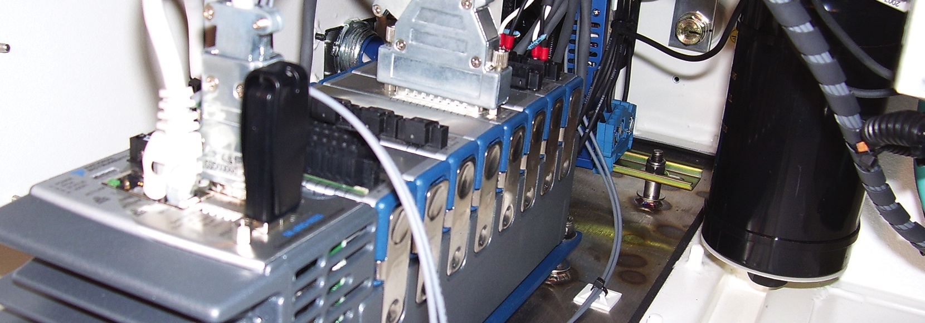
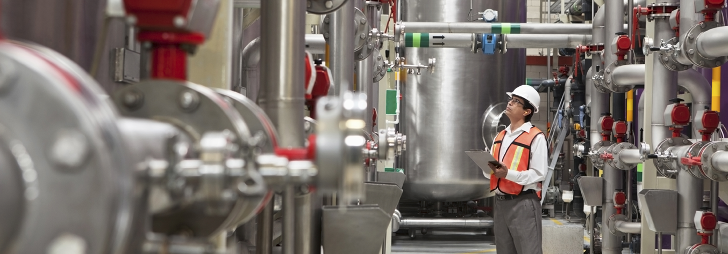

MAQUINARIA INDUSTRIAL
“LabVIEW graphical system design allows us to design modular software that can be easily scaled to meet the growing requirements of rapidly evolving wind energy technology.”
—Morten Pedersen, CIM Industrial Systems A/S
ni.com/innovations
Notes:
http://sine.ni.com/cs/app/doc/p/id/cs-12344

Slide 24
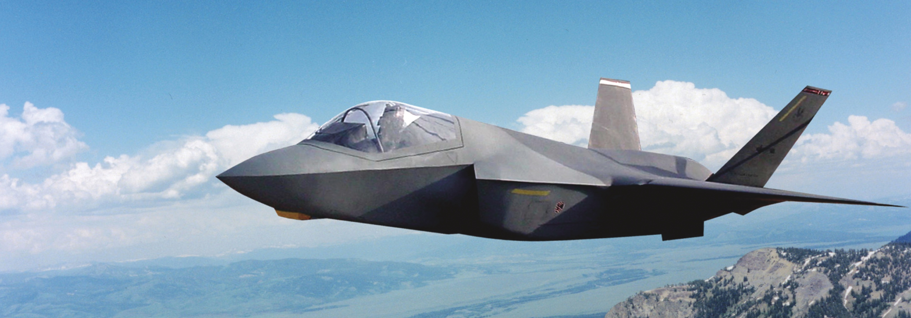
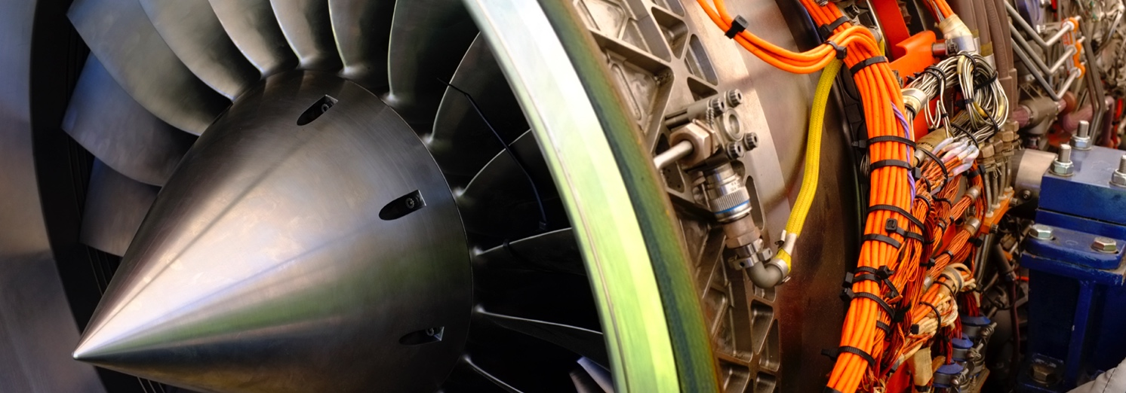

INDUSTRIA
AEROESPACIAL
“Through the use of advanced software architecture and NI hardware, G Systems was able to provide Lockheed Martin Aeronautics with a highly configurable, expandable system to meet current and future requirements of the F-35 VSIF (Iron Bird).”
—Dave Baker, G Systems LP
ni.com/innovations
Notes:
http://sine.ni.com/cs/app/doc/p/id/cs-505

Slide 25
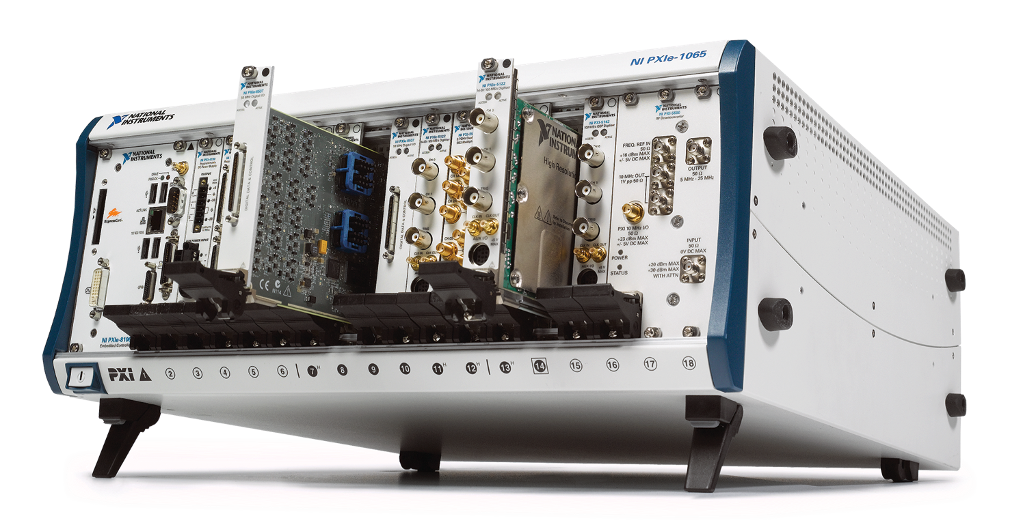
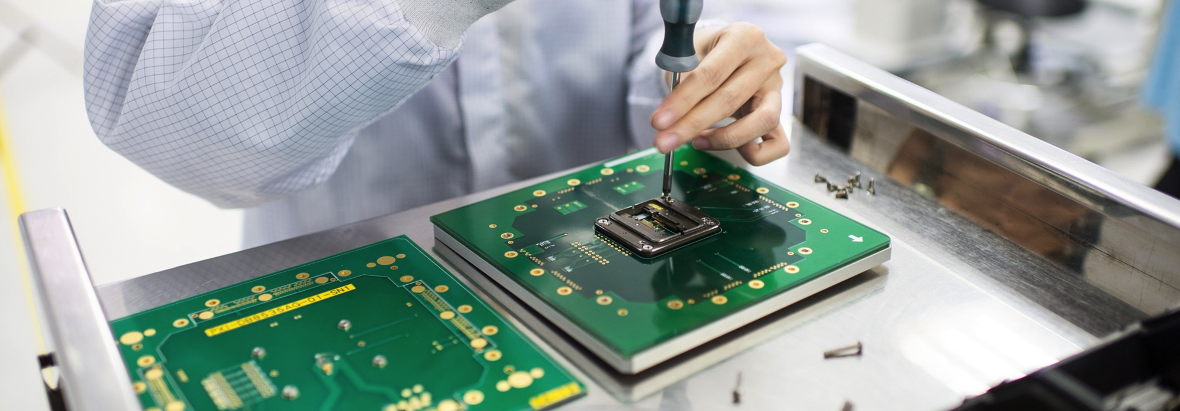

ELECTRONICA Y SEMICONDUCTORES
“The key to choosing NI products for Panasonic was the all-in-one compact enclosure, combinations of modules, the option to easily add features depending on our needs, and the ability to develop a program that has an intuitive graphical interface.”
—Takeuti Isao, Chief Engineer, Electronics Appliances
ni.com/innovations
Notes:
http://sine.ni.com/cs/app/doc/p/id/cs-12302
Confirm Logo Permission.

Slide 26


DOCENCIA E INVESTIGACIÓN
“Electronics used to seem so cryptic to me, but using NI tools in the new labs made everything so much more understandable. It’s given me the confidence to experiment with electric circuits and try out some of my own projects.”
—Joshua Elijah, Second-Year Student, The University of Manchester
ni.com/innovations
Notes:
http://www.ni.com/landing/118/en/
Confirm Logo Permission.

Slide 27
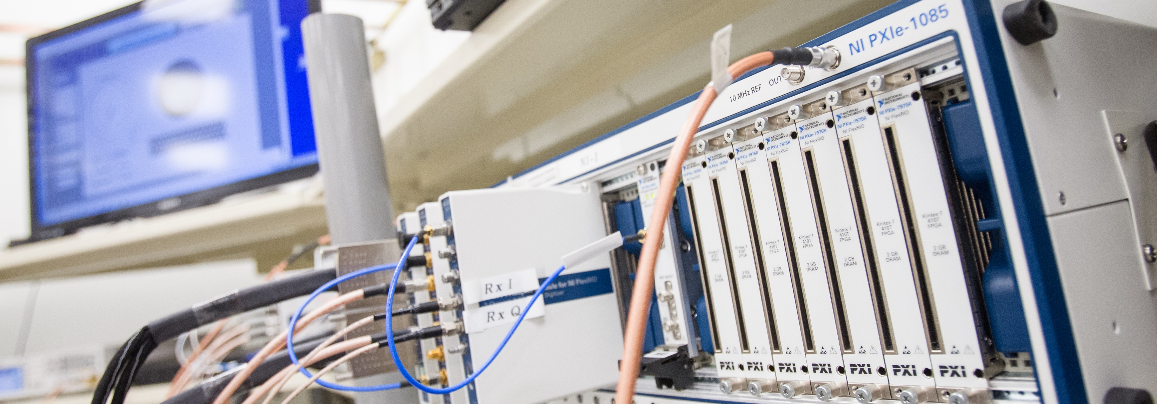


COMUNICACIONES
“Together, NI and Nokia Networks are reinventing the future of wireless communication and powering the fastest cell phone networks ever.”
—Lauri Oksanen, Nokia Networks
ni.com/innovations
Notes:
http://sine.ni.com/cs/app/doc/p/id/cs-16752

Slide 28
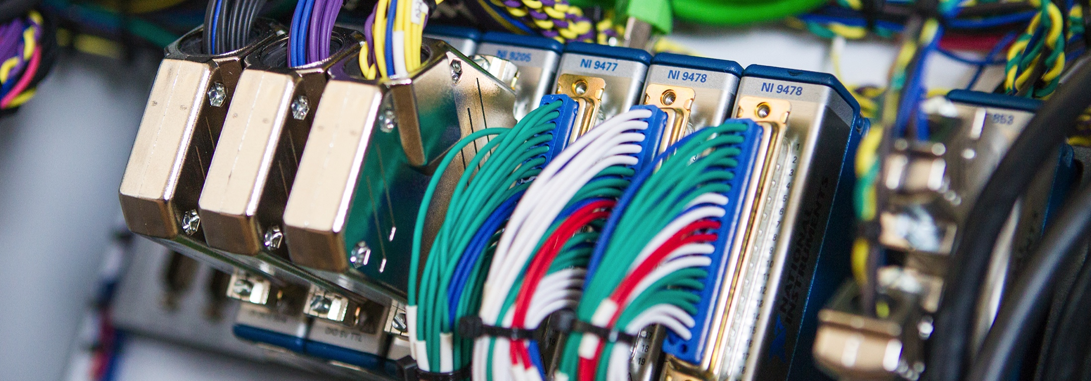


TRANSPORTE Y EQUIPO PESADO
“[The NI platform] just brings a level of control that I don’t know exists in any other platform.”
—Steven Aposhian, FireFly Equipment
ni.com/innovations
Notes:
http://sine.ni.com/cs/app/doc/p/id/cs-16758

Slide 29
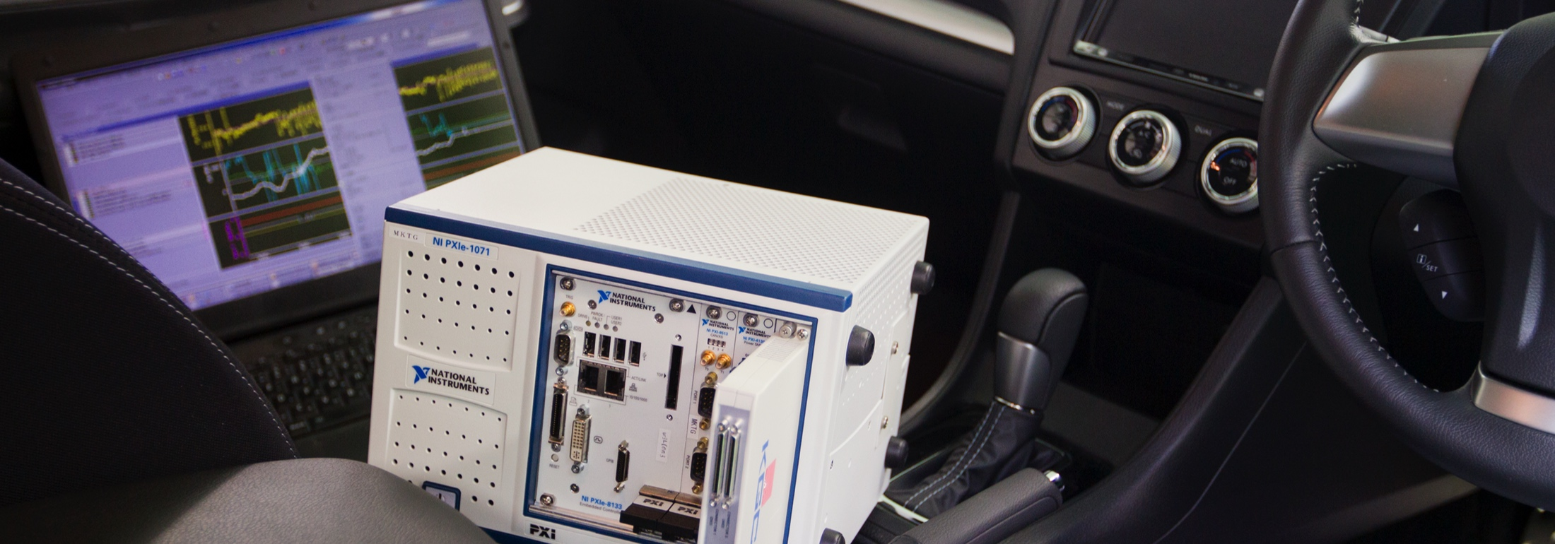
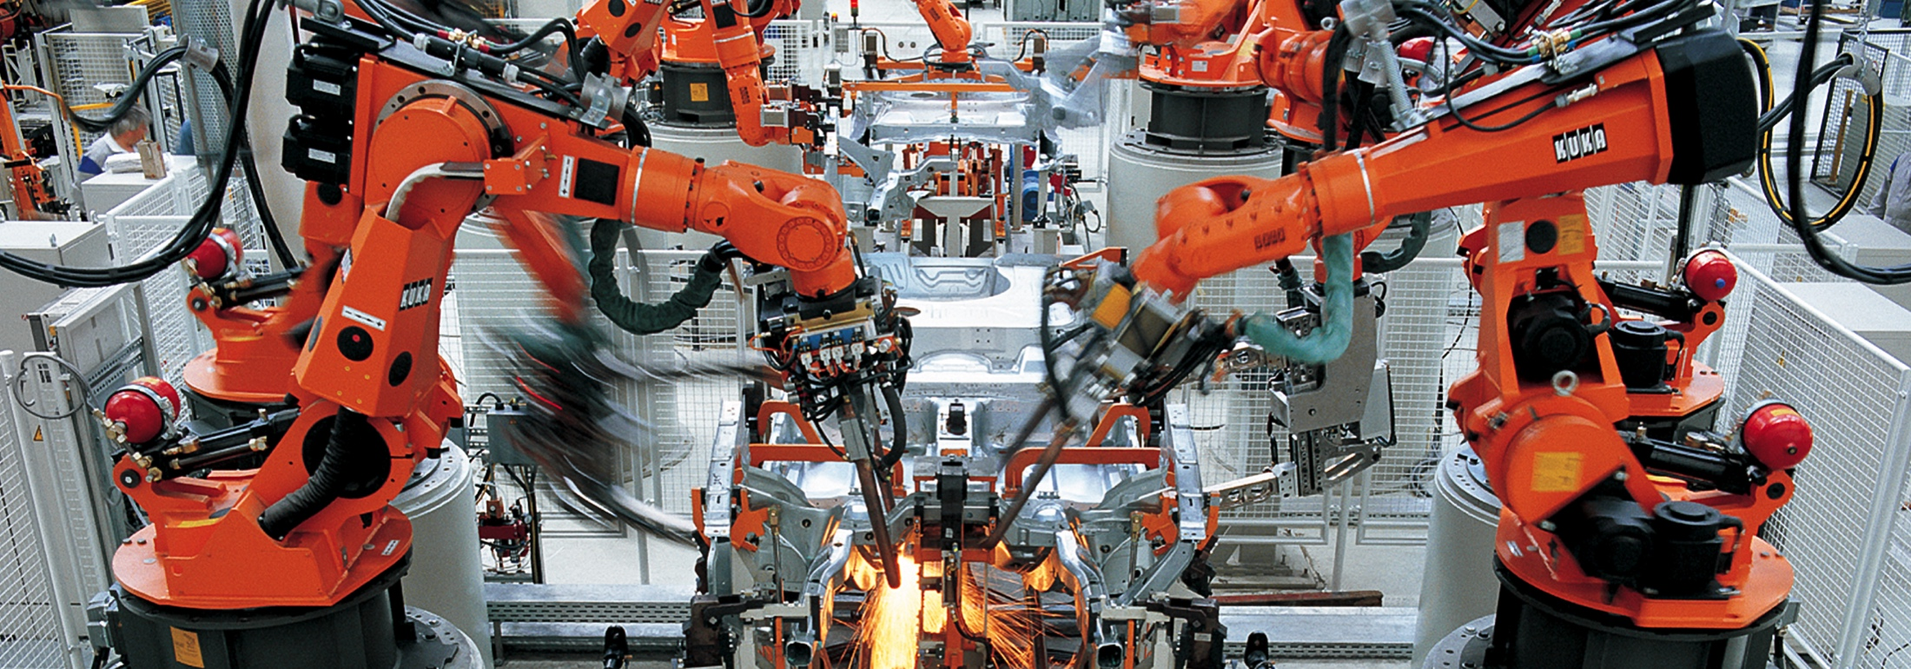

AUTOMORIZ
“By adopting FPGA-based simulation using the NI hardware and software platforms, we achieved the simulation speed and model fidelity required for verification of an electric motor ECU. We reduced test time to 1/20 of the estimated time for equivalent testing on a dynamometer.”
—Tomohiro Morita, FUJI Heavy Industries, Ltd.
ni.com/innovations
Notes:
http://sine.ni.com/cs/app/doc/p/id/cs-15982

Slide 30


ENERGIA
“The high processing power of CompactRIO allows us to gather and analyze large amounts of data from anywhere on the grid as well as compile and analyze all the data to see grid-wide trends to optimize our investments to meet the energy needs of the next generation.”
—Peter Haigh, National Grid UK
ni.com/innovations
Notes:
http://sine.ni.com/cs/app/doc/p/id/cs-16543

Slide 31










































Aug. 3-6, 2015
Aug. 3-6, 2015
Al ritmo actual, el siglo 21 acumulará el mismo avance tecnológico que los 20,000 años anteriores. — Ray Kurzweil
…
…
1a Revolución Industrial
2a Revolución Industrial
3a Revolución Industrial
4a Revolución Industrial
Aug. 3-6, 2015
Aug. 3-6, 2015
Aug. 3-6, 2015
Siglo XVIII
Siglo XIX
Siglo XX
Siglo XXI
Aug. 3-6, 2015
Aug. 3-6, 2015
Notes:
Students will feel what futurists like Ray Kurzweil have spoken about in the past – that the rapid innovation in technology is accelerating, and they need to keep pace – and their understanding of complex systems is the only way. Kurzweil has articulated best that we’ve harnessed the power of exponential progressions. Things that progress exponentially tend to confound our understanding, because we think linearly. As a simple example, 30 linear steps takes you about 60 feet; while 30 exponential steps takes you over 1 million miles. This accelerating progression of technology is resulting in the disruption of industry after industry – and you are the visionaries that are challenged with preparing this generation of students to be able to innovate at that pace.

Slide 32
¡La velocidad sí importa!
Los estudiantes están descubriendo lo que aún no conocen.
Los investigadores están develando lo que aún nadie sabe.
La velocidad con la que descubren es importante.

Slide 33




Acelerando el Descubrimento
De la Secundaria al Impacto Social
Crear un
Impacto Social
Descubrir lo Desconocido
Preparar a los
Futuros Ingenieros
Inspirar a la próxima Generación
Secundaria
Grado Universitario
Investigación Académica
Empresa e Industria

Slide 34


Algunos Desafíos Tecnológicos Cruciales
Advance
Personalized Learning
Make Solar
Energy Economical
Advance Health Informatics
Enhance Virtual Reality
Reverse-Engineer
the Brain
Engineer Better Medicines
Provide Access
to Clean Water
Develop Carbon
Sequestration Methods
Restore and Improve
Urban Infrastructure
Secure Cyberspace
Manage the
Nitrogen Cycle
Provide Energy
From Fusion
Prevent Nuclear
Terror
Engineer the Tools
of Scientific Discovery
Notes:
And engineers are faced with challenges that impact the world at a huge scale – from curing cancer, to climate control, water purification and more. In fact, the National Academy of Engineering identified these 14 grand engineering challenges as key issues society faces today.

Slide 35



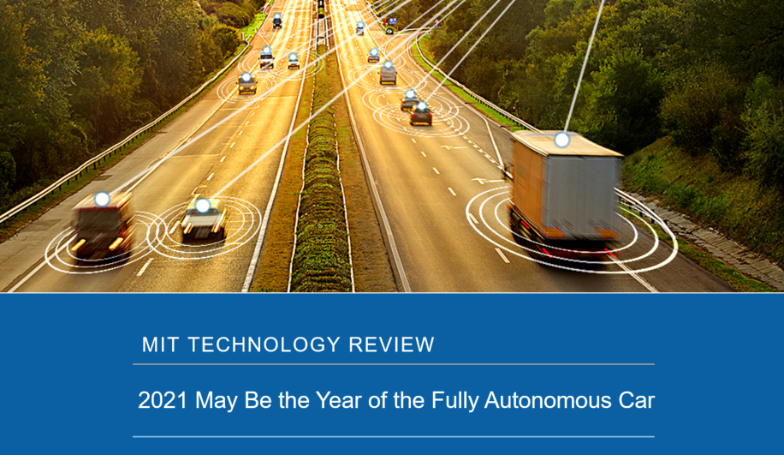

Slide 36
Tendencias y Desafíos

Slide 37

FORO ECONOMICO MUNDIAL
El 65% de los chicos que ingresan hoy a la Escuela Primaria, desarrollarán sus vidas con trabajos que todavía no existen.

Slide 38
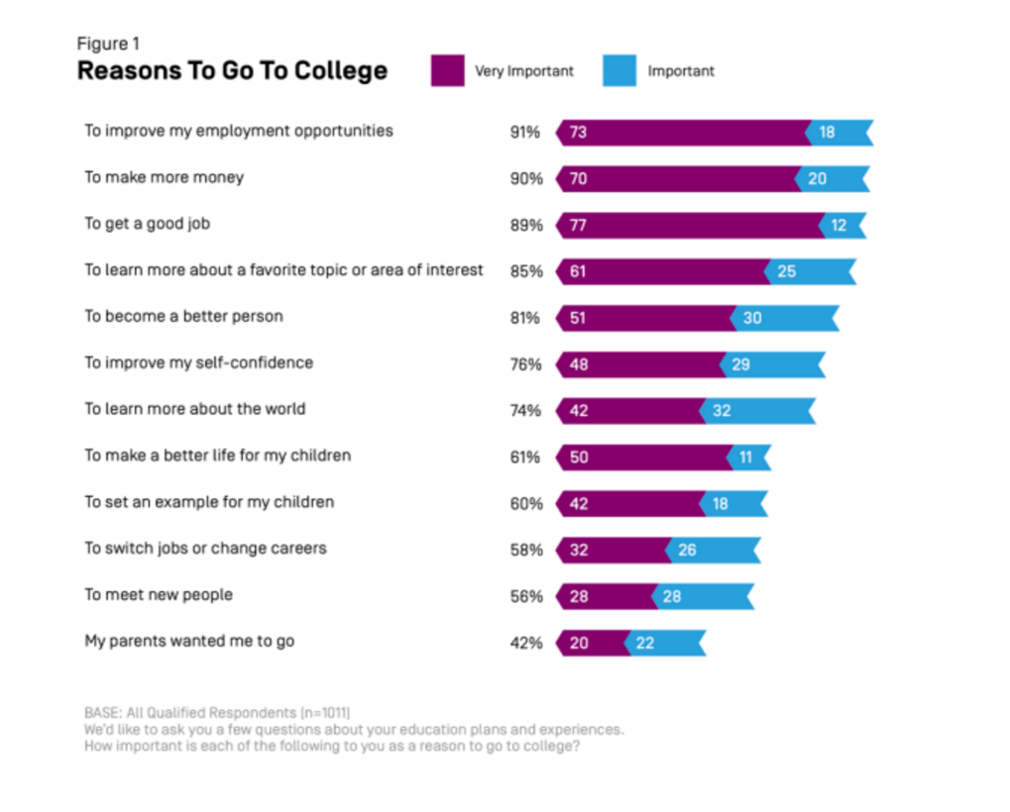
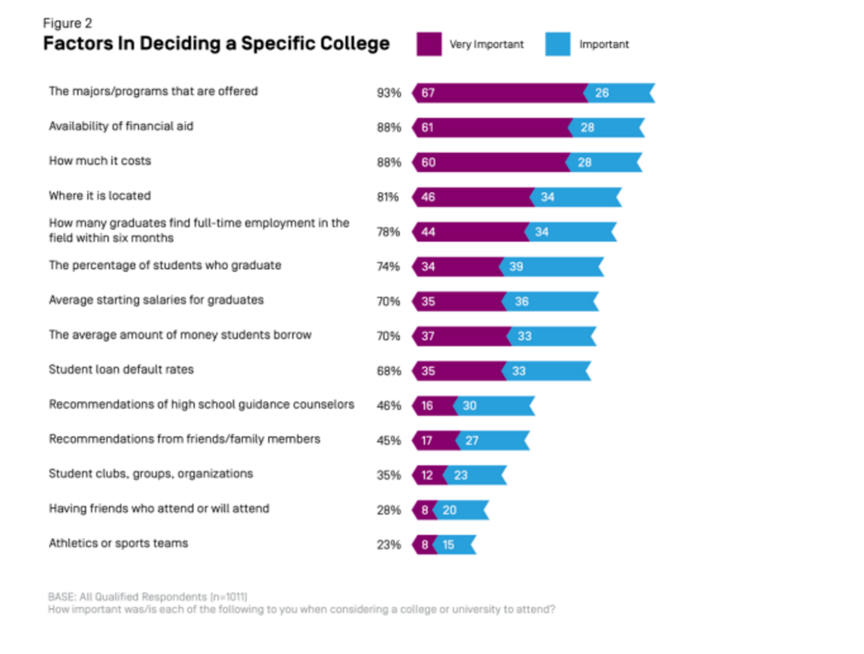
¿Qué preocupa a los estudiantes? (encuesta en USA)
La empleabilidad ocupa un lugar preponderante
Notes:
https://www.newamerica.org/education-policy/edcentral/collegedecisions/

Slide 39
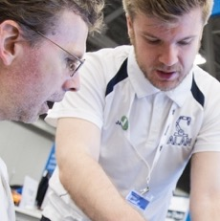
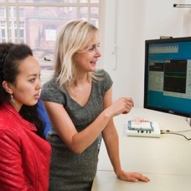
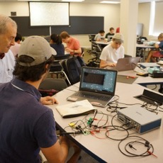
Los estudiantes necesitan aprender a trabajar en grupo resolviendo problemas complejos con un enfoque multidisciplinario
Entusiarmar y retener a los alumnos resolviendo problemas de diseño de la ingeniería real. ​
Los estudiantes deben hacer trabajos grupales y multidisciplinarios usando las herramientas modernas de la ingeniería​
Transforming Undergraduate Education ​
in Engineering by ASEE
Educating the Engineer of 2020 ​
National Academy of Engineering
Criteria for Accrediting Engineering Programs ​
Washington Accord (of Accreditation)​
Notes:
Engineering educational bodies around the world regularly make recommendations to improve the efficacy of the classroom. These include working on teams to solve real, multidisciplinary problems using modern engineering tools.

Slide 40
De los Sistemas Aislados a los Sistemas Interconectados
INVESTIGACION Y DESARROLLO DE SISTEMAS INGENIERILES
5G
Internet de las Cosas
Grillas Inteligentes
MIMOs masivos
Vehículos autónomos
Sistemas Ciber-Físicos
Coordinación inteligente de las industrias
SUBSISTEMAS
Mechatrónica
Sistemas Embebidos
Comunicaciones Inalámbricas
CONCEPTOS CENTRALES
Circuitos
Intro al Control
Proceso de Señales
Intro a la Ingeniería
Sensores y Actuadores

Slide 41








D
Diseño de los Sistemas de Ingeniería
Preparando a los estudiantes para las megatendencias de la próxima década
¿Cuáles serán??
…
Megatendencias
Megatendencias
¿Megatendencias del futuro?
…
2017
2020
2021
2022
2030
2040
2050
Notes:
As we stand here in 2017 we can see how megatrends like 5G, IoT and the autonomous vehicle will change the landscape for that future class in the next 3-5 years. But it is without question that as we move forward into the futures predicted by Ray Kurzweil and Moore’s Law – there will be a continued rate of innovation for challenges we have not yet even imagined and trends that are beyond even our science fiction. Predicting what 2030, 2040 or 2050 might look like - is difficult, but I am confident in saying that the those innovations will continue to require an ever more complex networked system of engineering systems. Leaders such as yourself know that your institution must produce that pipeline of students capable of tackling those challenges and we need to rapidly transition them from those core concepts, to the engineering system level paradigm that will drive us from 5G to 6G, to new forms of ever cleaner energy and to an ever more connected world.
Your students today, and tomorrow, must be engineering system-ready to tackle those challenges and deliver on the promise of tomorrow. To get those students to the point of success - we must never forget that the rate of discovery will matter for your students, for your researchers and ultimately industry. Our ability to rapidly deliver engineering intuition in the 4 short years you have with your students is critical and our work together can ensure that students have the tools and platforms to accelerate their discovery.
We are all engineers that have chosen our respective roles because we choose to be a part of significant change and inspire the innovators of tomorrow. I believe that the ECE departments will be a central force and NI is ready to partner with you towards that success.

Slide 42
¿Cómo coopera NI con las Instituciones Académicas?

Slide 43





Modelo Asociativo de NI con las Instituciones Académicas
Incrementar la relevancia para la Industria con un Centro de Excelencia y mecanismos de Certificación de Competencias
Aumentar el Entusiasmo y Retención a través de Cambios Curriculares
Colaborar para Aumentar el Presupuesto destinado a la Investigación
Consolidar el Compromiso y Mejorar la Empleabilidad
Apoyar las Iniciativas de Impacto Social Global

Slide 44






Cambio y Mapeo Curricular
DEPARTMENTOS
APLICACIONES
ELECTRONICA ANALOGICA, DIGITAL Y DE POTENCIA
INGENIERIA MECÁNICA Y MECATRÓNICA
INGENIERIA ELECTRICA Y DE COMPUTACION
INGENIERIA BIOMEDICA
CONTROL BASICO Y AVANZADO
ACTUADORES, SENSORES Y SISTEMAS MECATRONICOS
COMUNICACIONES EN BANDA BASE E INALAMBRICAS
INGENIERIA CIVIL
INGENIERIA QUIMICA
INGENIERIA DE SISTEMAS
INTRO A LA INGENIERIA, MEDICIONES E INSTRUMENTACION

Slide 45








Cambio y Mapeo Curricular
DEPARTMENTOS
APLICACIONES
Dispositivos
para los Estudiantes
Plataformas de Laboratorio
Plataformas Industriales
INGENIERIA MECÁNICA Y MECATRÓNICA
INGENIERIA ELECTRICA Y DE COMPUTACION
INGENIERIA BIOMEDICA
INGENIERIA CIVIL
INGENIERIA QUIMICA
INGENIERIA DE SISTEMAS

Slide 46
Cooperar para Incrementar el Presupuesto para Investigación
Acelerar el Descubrimiento a través de Areas de Aplicación
Inovación en Areas Clave
Plataformas para la Innovación
SISTEMAS AVANZADOS DE MEDICION
Multi-Channel Measurement Systems
ADQUISICION DE DATOS
AUTOMOTRIZ
HIL, ECU Test, Autonomous Radar
CONTROL EMBEBIDO
Colaboración
Asistencia al investigador para desarrollar las propuestas
Conexión con colegas y expertos en el dominio de interés
Conexión regional o global con otros socios académicos de NI para desarrollar trabajos colaborativos
COMUNICACIONES
SDR, mmWave, Massive MIMO
ENSAYO ELECTRONICO
ENERGIA
Smart Grid, Power Analysis, HIL, Condition Monitoring
INSTRUMENTACION
BIOMEDICA
Medical Imaging, Medical Devices
DISEÑO DE SISTEMAS INALAMBRICOS
MONITOREO INTEGRAL DE LA SALUD
Data Logging, Advanced Measurements
ENSAYOS INALAMBRICOS

Slide 47

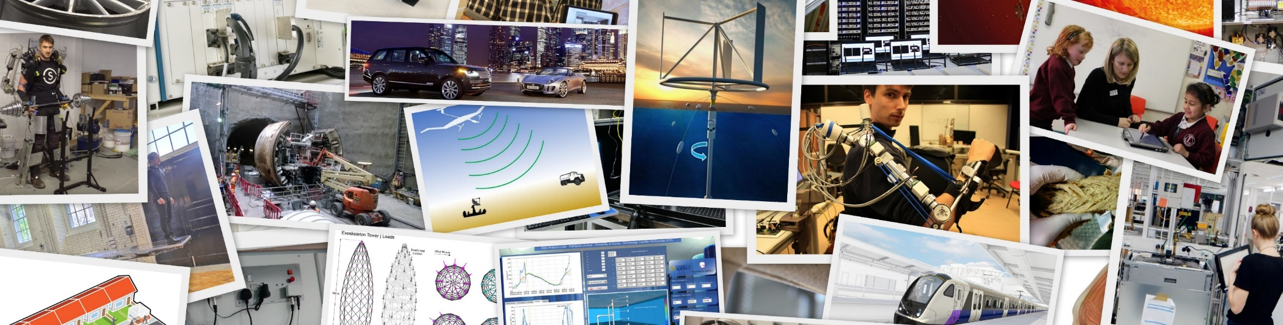
Premios NI a la Ingeniería con Impacto
Concurso de aplicaciones técnicas que exhibe los proyectos más innovadores basados en software y hardware de NI. Brinda una oportunidad especial para compartir sus innovaciones con la comunidad y establecer contacto con los gente importante de la comunidad NI, la prensa, muchos líderes industriales y los otros premiados en una importante ceremonia y cena de gala.
Notes:
To enter… you just have to submit a paper (at around 1000 words, it is very short by academic standards)… that details an innovative project you have worked on, and how you used the NI platform

Slide 48

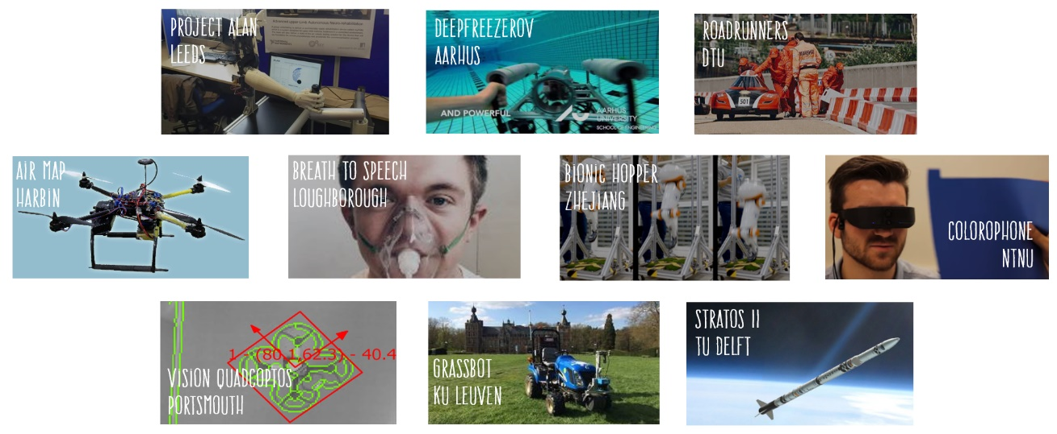
Deliver Student Engagement & Employment
Competition Prizes
Local Grand Prize: Regional Industry Award Recognition Global Grand Prize: Global Award Recognition, and a Trip to NIWeek

Slide 49
Un caso argentino:
¿Qué adquirió la UTN?

Slide 50



Licencias Académicas de Sitio (ALS por sus siglas en Inglés)
Es el modelo de licenciamiento que varios miles de universidades de todo el mundo están usando para acceder a las herramientas de software desarrolladas por NI.
La ASL ofrece un descuento increíble sobre licencias de software industrial valuado en cientos de miles de dólares.
Notes:
The versions of NI Software (LabVIEW, Multisim, Diadem, TestStand etc.) are exactly the same as those sold to industry.
It is important to note that ASL is ultimately a purchasing decision and licensing model. Customers will purchase ASL because they are bought into the benefits of LabVIEW or Multisim. It is important to begin your discussions around the power of the NI Platform.

Slide 51
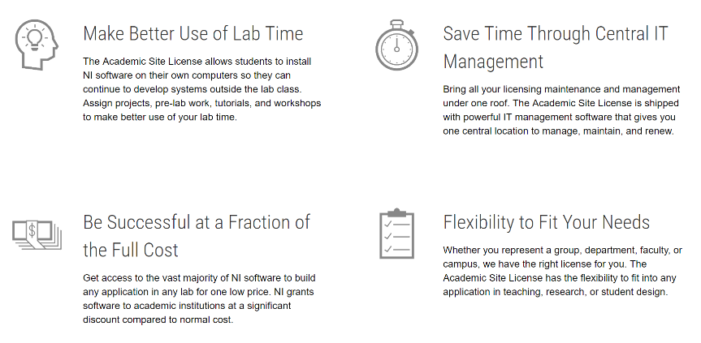
Licencias Académicas de Sitio – Características Principales
Notes:
If you remember just somethings from this presentation, remember that:
Academic Site License is the licensing model that thousands of universities around the world use to get NI software
And that these are the key benefits of ASL

Slide 52
Licencias Académicas de Sitio – Tipos
LabVIEW
LabVIEW CD&Sim
LabVIEW
Teaching ASL
LabVIEW
Teaching + Research ASL
Mathscript
Statechart
Real Time
FPGA
Robotics
Signal Express
LabWindows CVI
Diadem
LabVIEW NXG
LabVIEW Comms
DAQExpress
Multisim
Multisim Teaching & Research ASL
Multisim
Ultiboard
Notes:
We can’t sell or target someone on ASL until we have them bought into the fundamental software value to begin with
LabVIEW Message
Multisim Message
We will assume for the sake of progress that these are complete
The core evergreen values of LV/MS for teaching

Slide 53

¿Qué inlcuye la Licencia Académica de Sitio LabVIEW?
LabVIEW Professional Development System
NI DAQExpress
VI Package Manager
LabVIEW Control Design and Simulation Module
LabVIEW MathScript RT Module
LabVIEW Statechart Module
LabVIEW Softmotion Module
LabVIEW Digital Filter Design Toolkit
LabVIEW Robotics Module
LabVIEW Real-Time Module
LabVIEW FPGA Module
LabVIEW FPGA Xilinx Compilation Tools
LabVIEW myRIO Toolkit
LabVIEW roboRIO Toolkit
LabVIEW ELVIS RIO Control Toolkit
Automotive Diagnostic Command Set
LabVIEW LEGO MINDSTORMS NXT Module
LabVIEW Datalogging and Supervisory Control Module
NI Vision Development Module
ECU Measurement and Calibration Toolkit
LabVIEW Sound and Vibration Measurement Suite
LabVIEW Advanced Signal Processing Toolkit
LabVIEW Electrical Power Suite
LabVIEW Spectral Measurements Toolkit
LabVIEW Modulation Toolkit
LabVIEW DataFinder Toolkit
LabVIEW Unit Test Framework Toolkit
LabVIEW VI Analyzer Toolkit
LabVIEW Desktop Execution Trace Toolkit
LabVIEW Communications System Design Suite
NI TestStand
LabWindows/CVI
Measurement Studio
DIAdem
NI Vision Builder for Automated Inspection
NI Motion Assistant
Información completa a partir de este link:
http://www.ni.com/white-paper/8115/en/
Notes:
The LabVIEW academic site license contains a huge amount of software included almost all the LabVIEW toolkits and Modules. It gives customers the flexibility to move into any area of engineering and simplifies the selling experience.
Let me show you how the ASL enables an entire course structure from year 1 to capstone project. All industry SW

Slide 54
La Liciencia Académica de Sitio los tiene a cubierto

Slide 55
Licencia Académicas de Sitio LabVIEW – Módulos vs Aplicaciones
Intro a la Ingeniería
Proceso digital de señales
Desarrollo de software
Mecatrónica
Electrónica de Potencia
Lógica Digital
Robótica
Redes de Comunicación
Sistemas de Control
Comunicaciones Inalámbricas
Teoría de Señales y Sistemas
Diseño de Antenas y Radares
¡y mucho más!
Notes:
Why do you need all the different parts of the LabVIEW ASL? Let us show you how ASL has you covered no matter which teaching or research topic you are interested in.

Slide 56
Mucho más que Software

Slide 57
Programa de Servicio Estándar (SSP por su sigla en Inglés)
Versiones de Software
Soporte
Siempre al día con la última versión
Retrocompatibilidad completa
Vea el futuro con LabVIEW NXG*
Hable directamente con nuestros Ingenieros
Baje la carga del departamento TICs
Proteja las actividades de su staff
Mantenga su Proyecto al día
Cursos en Línea
Software p/los Estudiantes
Consiga el éxito más rápidamente
Ayuda a transitar la curva de aprendizaje
Preparación para la certificación de competencias
El mismo software en su PC y en la facultad
Estudiantes más productivos
Más satisfechos
Abre la puerta a proyectos muy interesantes
Notes:
*LabVIEW NXG is only in the LabVIEW Academic Site License solo si la licencia esta activa!!

Slide 58

Las ASL incluyen un número importante de licencias para estudiantes (modo Student Install)
NEW!
Student Install habilita a los estudiantes para que instalen en sus computadoras el mismo software que tienen en el laboratorio de la Facultad.
Esta instalación personal permite depurar mejor los trabajos de proyecto, presentaciones, clases BYOD (bring-your-own-device), ajustar la previa, hacer los deberes y aprovechar major los tutoriales.
La flexibilidad hace a la eficacia.
Notes:
$15,000 of industry standard software at no cost to the students solo si la licencia esta activa!!

Slide 59

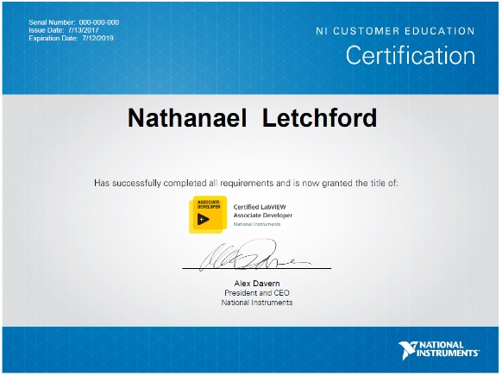
Incremente la relevancia para la industria
Certificación, Centro de Excelencia
Drive Industry Certification for Students and Professionals
Enhance Student Preparedness for Careers
35,000+ companies around the world are using NI technology. Provide students with the industry standard certification in LabVIEW (CLAD) to ensure they graduate with the in demand skills for engineering system design and test
Train Local Industry
Build closer relationships with local industry be delivering training and certification to local companies and employers, furthering your impact
Build Towards a Centre of Excellence
Specialize in specific domains and applications to provide increased value to students and local industry through specialized courses, consultancy and thought leadership.
Notes:
Requirements
LabVIEW Software
Academic Site License
NI Hardware
NI ELVIS (recommended), CompactDAQ, myRIO, myDAQ.
Must support 2:1 student ratio.
LabVIEW Academy Curriculum Package.
Appropriate Facilities to Teach the Class (classroom or lab).
Instructors must be CLADs.
Content Delivery
Teach 30 hours of classroom instruction.
Distribute 30 hours of homework exercises and projects.
Maintenance
Must meet all program requirements.
Maintain minimum CLAD pass rates.

Slide 60
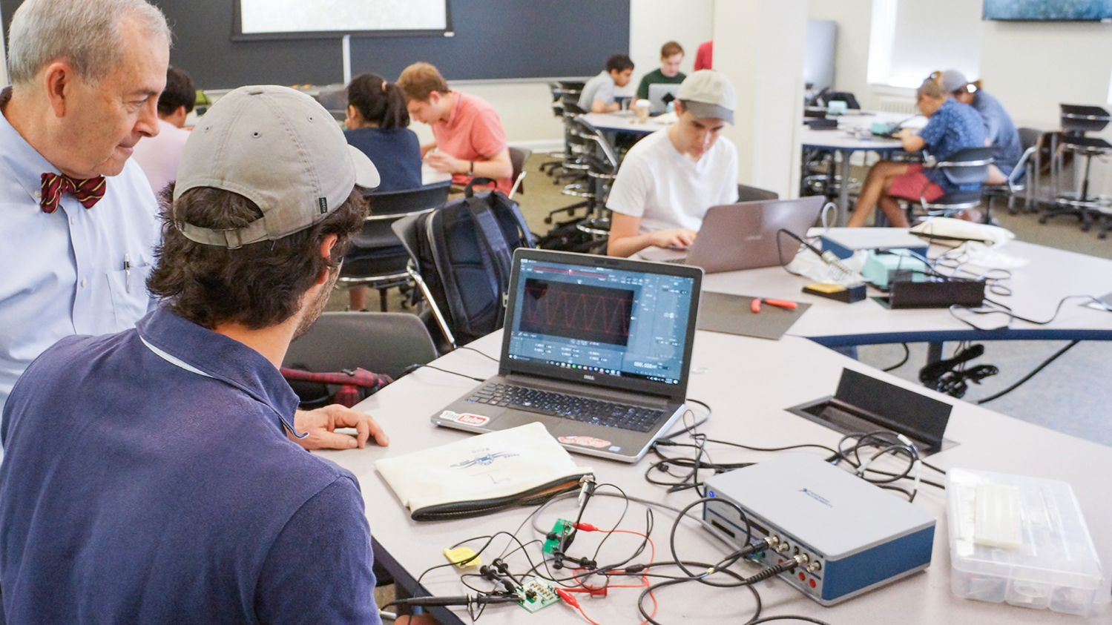
Mejora del Posicionamiento Institucional
First engineering school in the south,1819
#2 public university in the United States
2,700 undergraduate engineering students
The Electrical Engineering Department’s National Ranking Has
IMPROVED BY 16 POSITIONS

Slide 61
Estudiantes más satisfechos
Founded in 1824
Largest single-site university in the United Kingdom
#School of Electrical and Electronic Engineering ranked 2nd in the UK
67% to 98%
INCREASED STUDENT SATISFACTION
RATING FOR HANDS-ON EDUCATION

Slide 62
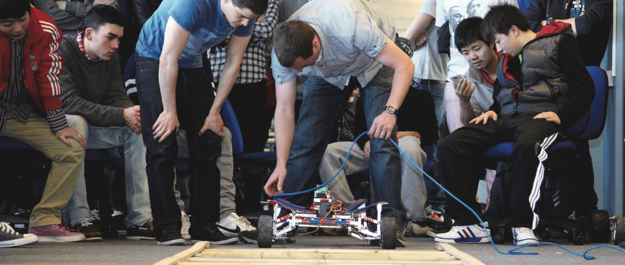
Aumento de la Empleabilidad
Founded in 1831
7th Largest University in the United Kingdom
Over 33,000 Students from over 145 Countries
Increasing Employability 19%
Through Curriculum Reform in the Mechanical Engineering Department

Slide 63
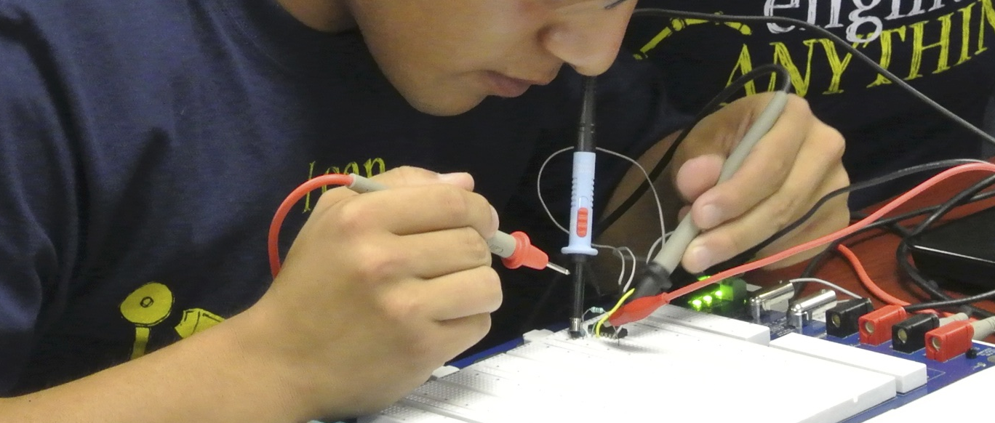


Descubrimiento de Talentos e Incentivo de Vocaciones a Nivel Nacional
Standardized on teaching resources, learning platforms across the entire school system
Driving student LabVIEW certification throughout the LabVIEW Academy program to improve student employability
Notes:
Logo sena

Slide 64
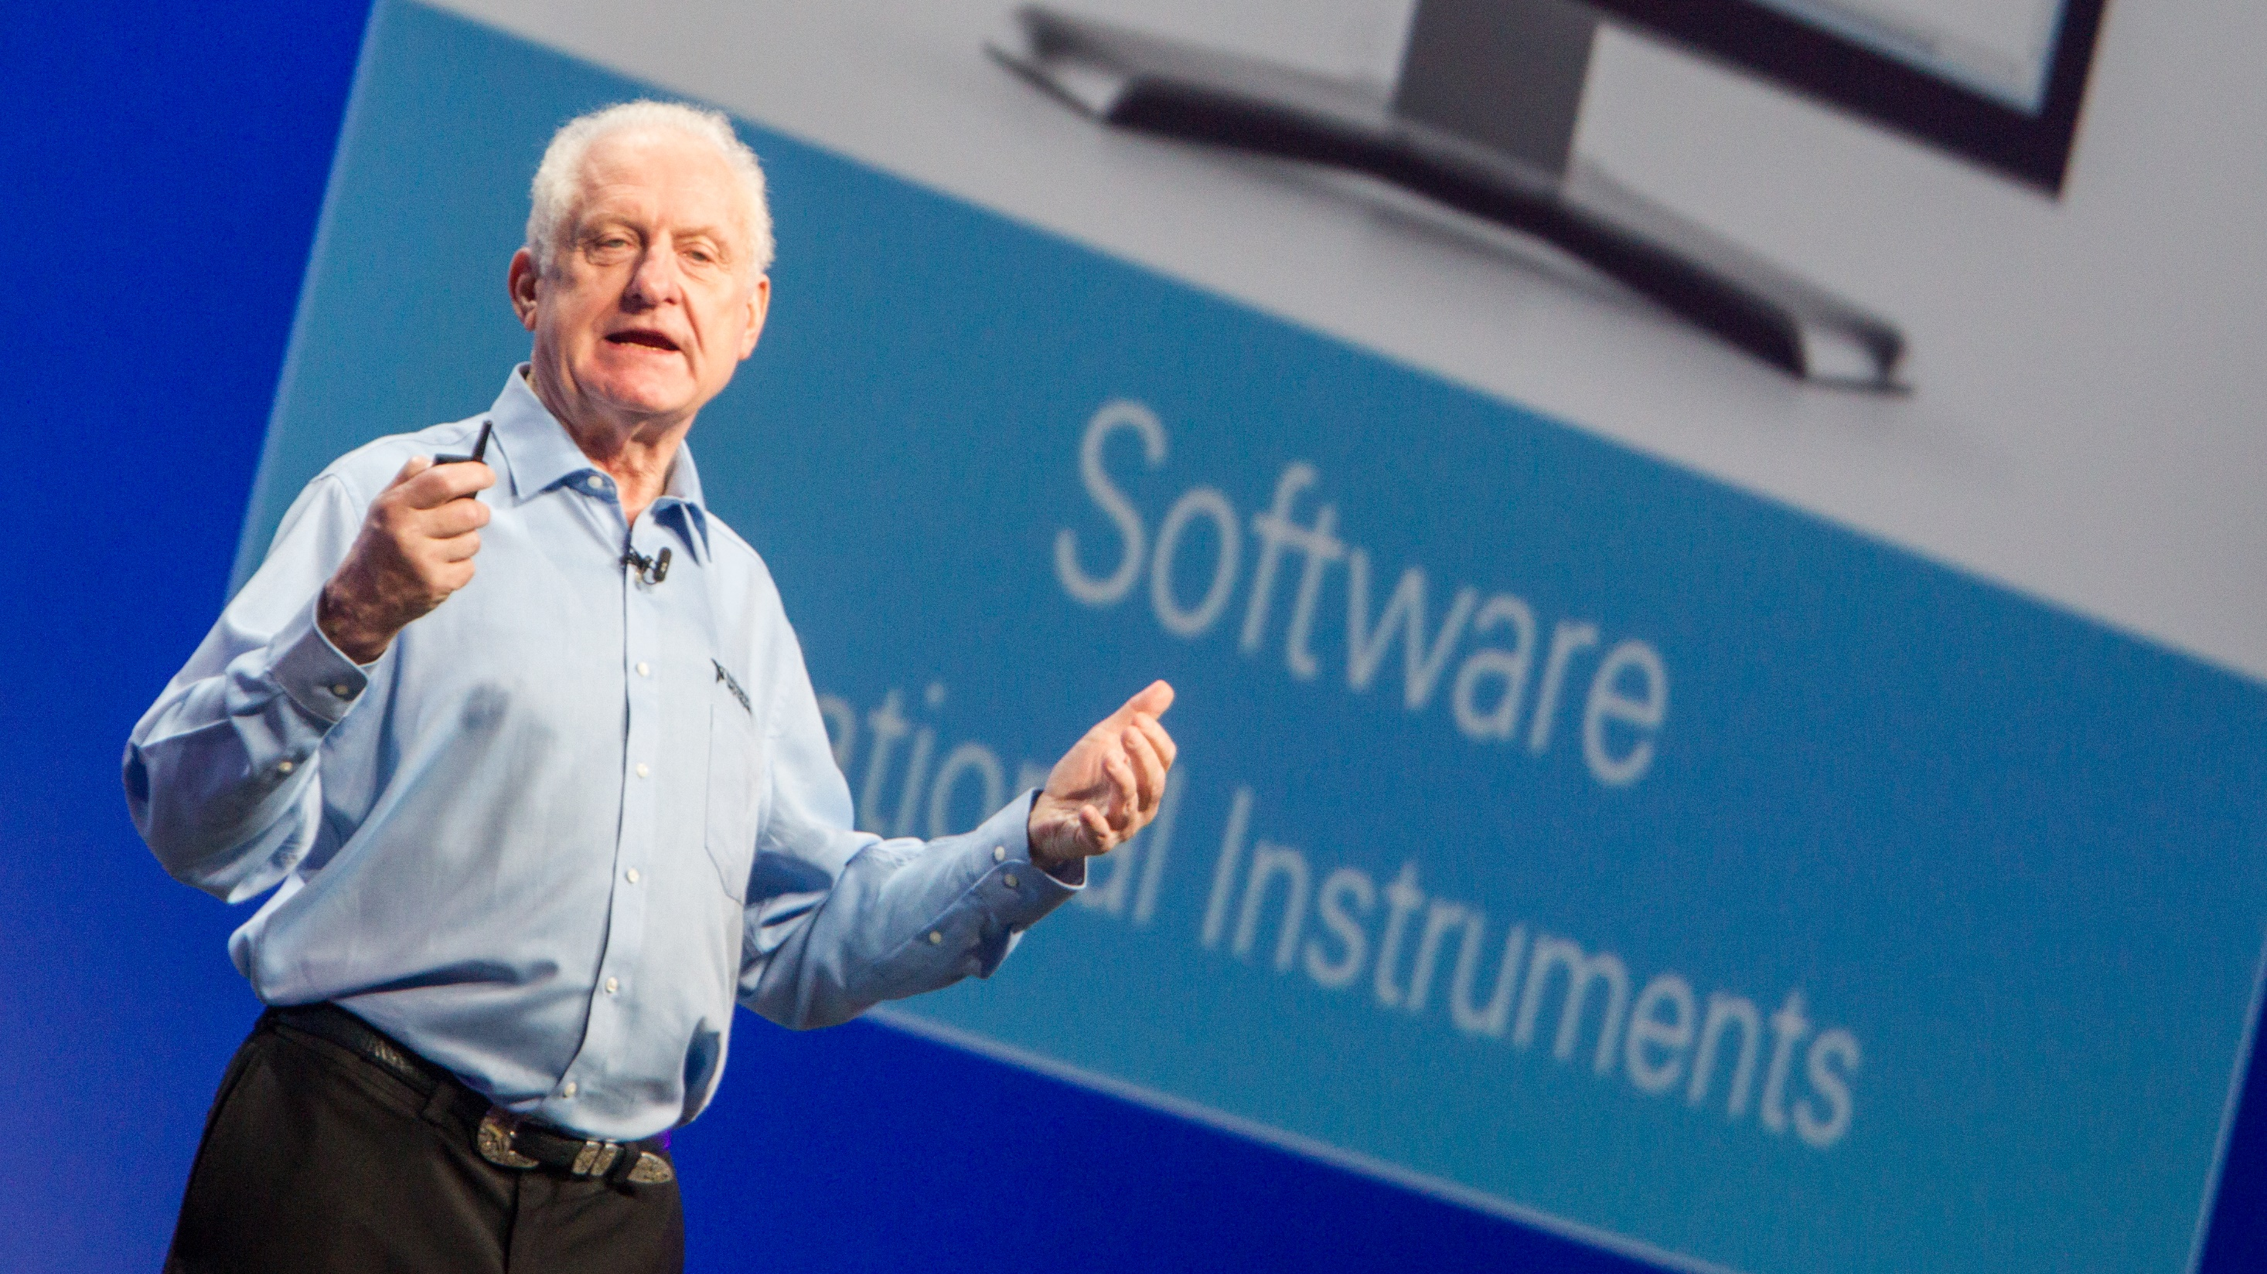
“
Todo empieza con la Educación.
En NI hemos tomado el compromiso de preparar a los estudiantes de hoy para los desafíos ingenieriles del mañana.
Dr. James Truchard
Notes:
As Dr T says- IT ALL STARTS WITH ACADEMIC
The academic program is a core part of NI
now lets welcomes Eloisa Acha…

Slide 65
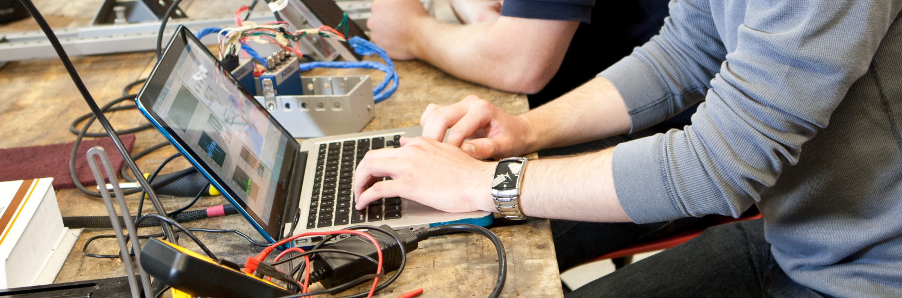

Empecemos hoy mismo
https://ni.com/asl
https://tecnoedu.com/NI

